Slide 1
Case Study 1
NC 812/ESD 812

Slide 2
Smart environment: Dimensions
Privacy
Security
Decision Making, Rule Engine
Information from the Data
Prediction, Data Mining etc.
Communication: Local and to the cloud
WSN
Hardware: Sensors and Actuators

Slide 3
Smart Warehouse
Let us try and design an IoT system for warehouse management or a Smart warehouse.
Such warehouse should require minimal human interaction. It should be able to do the desired tasks accurately, while conserving energy and maintaining the privacy.
It could potentially be able to advise the system/user of any upcoming events.

Slide 4
What makes it smart?
What kind of abilities are we looking for so that the warehouse management system may be considered “smart”?
Abilities:
Keep track of the inventory: list of items, number of items
Trend of consumption
Any suspicious activity
Anything else?

Slide 5
Sensors
What kind of sensors do we need for inventory tracking?
Suggestions?

Slide 6
Sensors : Requirements
Need a sensor that can determine the presence of “a” particular item, as well as movement of any items.
Need the sensing system to be accurate since error of margin must be low.
Warehouse is expected to be large in size
The turnover is expected to be high, the number of items and the attributes associated with them are expected to be large.

Slide 7
Sensor: RFID
Sensors
The sensing operation here could be that of
An article is present or not.
All the articles within the range must send their relevant details.
When the RFID reader sends a query, the tags within its range must communicate declaring their presence.
The data transferred can be a single bit or multiple bits (allowing the transmit different attributes).

Slide 8
What is RFID?
RFID = Radio Frequency IDentification.
It is an ADC (Automated Data Collection) technology that:
uses radio-frequency waves to transfer data between a reader and a movable item to identify, categorize, track.
It does not require line of sight or contact between reader/scanner and the tagged item.
Low cost components.
Other ADC technologies: Bar codes, OCR.

Slide 9
RFID vs. Bar Codes
Does not require human to manually pass item over scanner.
More accurate inventory count.
Can be incorporated into product, person, animal.
Can track each individual item.

Slide 10
RFID: Quick Introduction
The RFID (Radio Frequency Identification) technology allows automatic identification of information contained in a tag by using radio waves. An RFID tag contains an antenna and a microchip to transmit and receive.
The RFID technology is characterized by the deployment of three essential components: a microchip, an antenna and a reader. The tag is placed on the object or the person to be identified.
It contains information that is decrypted by the server by using an antenna for transmitting signals between the reader and the chip. The radio frequencies used by the RFID technology are in the 50 kHz to 2.5 GHz range.

Slide 11
RFID Applications
RFID based devices can be used for
maintaining inventory of stock in a grocery store
tracking shipment, e.g. FedEx, Blue Dart.
Tracking medical equipment in hospitals
Tracking students in school
Tracking endangered animals, tracking cattle etc.
Any of these systems are part of the smart environment we discussed earlier.

Slide 12
RFID Tags
Contains two main parts:
Silicon chips
Antennas
Components allow tags to receive and respond to radio frequencies queries from RFID transceivers.
Three types:
Passive
Semi-Passive
Active

Slide 13
RFID Tags cont.
Passive
Have no internal power supply
Electrical current inducted in antenna by the incoming signal proves power for integrated circuit in tag to power up and transmit response
Very Small, Limited Range, Unlimited Life
Semi Passive
Similar to passive tags, with the addition of a small battery
Battery powers the integrated circuit
Bigger, Longer Range, Limited Life
Active
Have their own internal power source
Many operate at fixed intervals
Also called beacons (broadcast own signal)
Large ( coin), Much larger memories, Longer range

Slide 14
RFID Tags
Tags can be attached to almost anything:
Items, cases or pallets of products, high value goods
vehicles, assets, livestock or personnel
Passive Tags
Do not require power – Draws from Interrogator Field
Lower storage capacities (few bits to 1 KB)
Shorter read ranges (4 inches to 15 feet)
Usually Write-Once-Read-Many/Read-Only tags
Cost around 25 cents to few dollars
Active Tags
Battery powered
Higher storage capacities (512 KB)
Longer read range (300 feet)
Typically can be re-written by RF Interrogators
Cost around 50 to 250 dollars

Slide 15
RFID tag memory
Read-only tags
Tag ID is assigned at the factory during manufacturing
Can never be changed
No additional data can be assigned to the tag
Write once, read many (WORM) tags
Data written once, e.g., during packing or manufacturing
Tag is locked once data is written
Similar to a compact disc or DVD
Read/Write
Tag data can be changed over time
Part or all of the data section can be locked

Slide 16
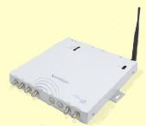
RFID readers
Reader functions:
Remotely power tags
Establish a bidirectional data link
Inventory tags, filter results
Communicate with networked server(s)
Can read 100-300 tags per second
Readers (interrogators) can be at a fixed point such as
Entrance/exit
Point of sale
Readers can also be mobile/hand-held

Slide 17
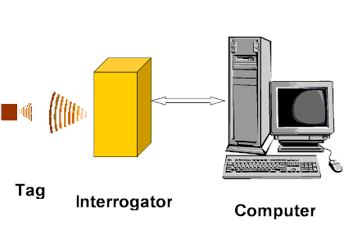
RFID System
Objects equipped with RFID tag
Tag contains transponder with digital memory chip.
Interrogator: an antenna packaged with transceiver and decoder.
emits signal activating tag.
Reader detects activation signal, decodes the data on the tag’s silicon chip.
Data passed to host computer.

Slide 18
Data and Energy Transfer
RFID systems can be classified based on size and quantity of information passing between different components of the RFID system. The information size can be:
One bit: The principle is based on a binary detection (absence or presence) of the RFID tag in the interrogation zone of the reader with an option to disable (usually by physical destruction of an element of the tag).
In this case the tags usually consist of a simple LC resonant circuit. At resonance, there is an oscillation causing an amplitude change at the reader. The oscillation depends on the distance between the chip and the reader and the quality factor of the antennae

Slide 19
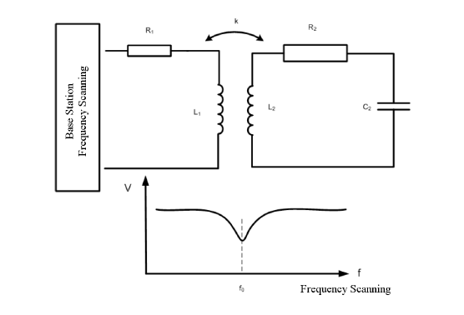
Inductive Coupling

Slide 20
N bit Transfer
Two types of procedures: In the first type, energy is continuously transferred from the reader to the chip, irrespective of the exchanged data flow. In the second procedure, energy is transferred from the reader to the RFID chip in a synchronous and non permanent way, i.e. sequential with the exchanged data flow.
For RFID systems performing a continuous energy transfer during communication, we can refine the classification by considering the manner in which the data exchange is performed. The data exchange may be simultaneous or alternate between the reader and the RFID chip.

Slide 21
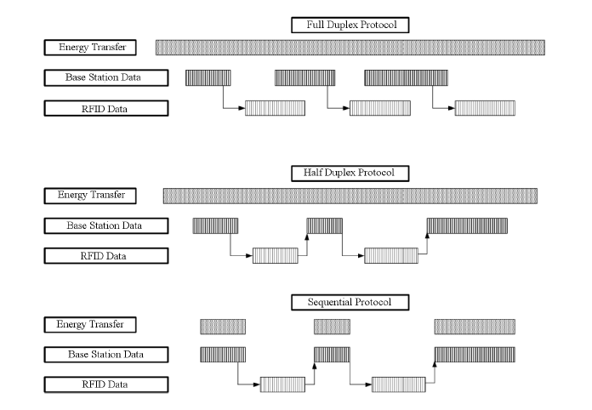
N-bit Transfer

Slide 22
What is the N bit data?: Barcode
A barcode is an optical machine-readable representation of data relating to the object to which it is attached. Originally barcodes systematically represented data by varying the widths and spacings of parallel lines, and may be referred to as linear or one-dimensional (1D).
They have evolved into rectangles, dots, hexagons and other geometric patterns in two dimensions (2D). Although 2D systems use a variety of symbols, they are generally referred to as barcodes as well. Barcodes originally were scanned by special optical scanners called barcode readers.

Slide 23
Universal Product Code (UPC)
The Universal Product Code (UPC) is a barcode symbology that is widely used in the United States, Canada, the United Kingdom, Australia, New Zealand, and in other countries for tracking trade items in stores.
The most common form, UPC-A, consists of 12 numerical digits, which are uniquely assigned to each trade item. UPC is the barcode mainly used for scanning of trade items at the point of sale.
Each UPC-A barcode consists of a scannable strip of black bars and white spaces, above a sequence of 12 numerical digits. No letters, characters, or other content of any kind may appear on a standard UPC-A barcode. The digits and bars maintain a one-to-one correspondence - in other words, there is only one way to represent each 12-digit number visually, and there is only one way to represent each visual barcode numerically.

Slide 24
Two dimensional Codes
One-dimensional codes work fine for carrying small amounts of data like numeric product codes. For larger data, e.g. inventory management, shipment tracking more data may be needed.
One solution is the stacked bar code, which, contain a number of 1-D codes piled one on top of another.
2-D bar codes (sometimes called matrix codes) carry information in two directions: vertically and horizontally. They are capable of holding tens and even hundreds of times as much information as 1-D bar codes. E.g., Denso Wave's QR Code, can hold more than 7,000 digits or 4,000 characters of text, whereas even the most complex 1-D codes top out around 20 characters. 2-D bar codes are also small and easy to scan.

Slide 25
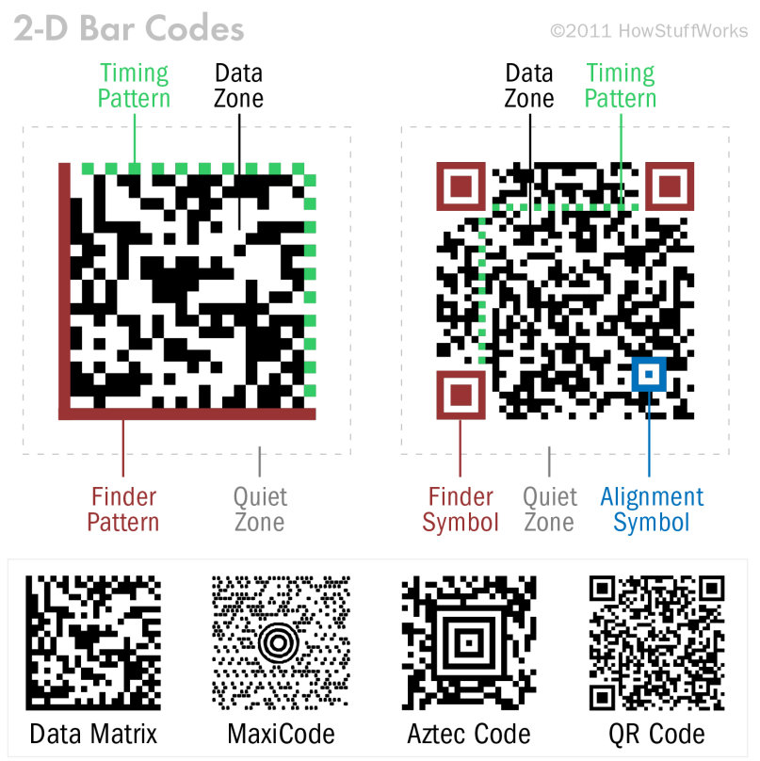
2 D Codes

Slide 26
Sensors
When the RFID reader sends a query, the tags within its range will communicate information as 1 bit (present/not), or multiple bits depending on whether the tag read is 1 D or a 2 D tag.
In addition there can be other sensors attached to the tag and more information may need to be communicated.

Slide 27
RFID Tags: Classification
We can classify RFID tags based on their features. Five classes are usually defined:
Class 0: in this category, RFID chips have a binary detection function (absence or presence) but do not provide any indication of identification data. They are mainly used for electronic article surveillance (EAS). These chips can contain simple passive components without wired logic circuitry.
Class 1: RFID chips have an identification function and contain unique data stored in a read-only memory WORM (write-once read-many). Class 1 RFID tags are generally passive, but they can also be semi-passive or even active.
Class 2: RFID chips have memory that can be used for reading and writing, where data can be updated. By consequence, the main feature of Class 2 chips is traceability since they can be reused in a process where it is necessary to identify and update data related to transformation steps.

Slide 28
RFID Tags: Classification
Class 3: Class 3 RFID chips contain memory, sensors that can record data such as temperature, pressure or acceleration. For processing data, sensors require a storage element even in the absence of RFID readers. Energy source should be embedded in the RFID chips for semi-passive or active use.
Class 4: RFID chips, equipped with sensors and memories, have adequate resources to process data and communicate independently to establish wireless ad-hoc networks between them. They should be active to initiate communication. From a functional point of view, these chips are part of the “smart dust” paradigm developed by researchers at the University of Berkeley in California. Their goal is the deployment of distributed networks with thousands of nodes that are Class 4 RFID chips.

Slide 29
Smart environment: Dimensions
Privacy
Security
Decision Making, Rule Engine
Information from the Data
Prediction, Data Mining etc.
Communication: Local and to the cloud
WSN
Hardware: Sensors and Actuators

Slide 30
Communication modes
Waveforms and usual communication codes of RFID systems
There are two main communication protocols between a RFID tag and a RFID reader:
TTO (Tag Talk Only) protocol, only the RFID tag transmits data. The RFID tag transmits its data regularly when it is provided;
RTF (Reader Talk First) protocol, the reader is the master of the communications. It is used in most RFID technologies.
Typically, when an RFID tag enters into the magnetic field of a reader, it waits for a request from the reader before transmitting its identity code.

Slide 31
Communication Modes
In the case of a process of continuous energy transfer and data transmission in Half Duplex (HDX) mode, the communication protocol between a reader and an RFID tag is composed of three phases:
Recovery phase of the RFID tag: the reader sends an electromagnetic wave to the RFID tag to provide it with needed energy for its operation. Then the tag stays at a waiting state until it receives an instruction from the reader.
Instruction phase: the reader sends an instruction (typically a request) to the RFID tag.
Reading phase: the RFID tag sends its reply corresponding to the request of the reader.

Slide 32
Signals, Modulation etc.
The N bit data must be transmitted over the air to the reader reliably, and that involves some data coding and modulation.
Due to the low hardware and software resources embedded in RFID tags and regulatory restrictions on the emission of radio power for readers, the choice of signal modulation and data coding is limited.
The data to be transmitted in relatively small but transmit power is lower resulting in low SNR. Data Coding is used to improve synchronization abilities.

Slide 33
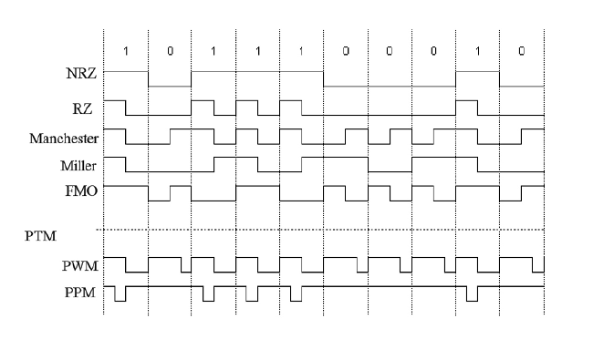
Data Coding

Slide 34
Data Coding
In NRZ (for Non-Return to-Zero) code that associates the high logic level with the binary value 1 and the low logic level to the binary value 0.
In RZ coding, the signal drops back to 0 V after each binary value.
The Manchester coding is an example of the coding by transition. It designates a binary value by the sign of the edge at the half-period instant of each bit. A rising edge in the middle of the symbol time corresponds to the binary value 0 and a falling edge corresponds to the binary value 1.
The transition in the middle of the symbol time is vital for signal synchronization at the reception and in particular for anti-collision detection processes when multiple cards using this coding type are in the operating area of the RFID reader.

Slide 35
Data Coding
“Miller code” uses a transition at half the symbol time to encode the binary value 1. If a sequence of 0 bits happens, a transition at the beginning of the symbol time is added.
FM0 (or Bi-Phase Space) is similar to the Miller coding, as it reverses the phase at the beginning of each period of symbol time while for the bit 0, it adds a phase inversion in the middle of the symbol time..
Other coding schemes transmit information by Pulse Time Modulation (PTM). In this category, we use Pulse Width Modulation (PWM), Pulse Position Modulation (PPM) and Pulse Interval (PIE) coding methods.

Slide 36
Data Coding
Coding techniques for RFID information should consider the following constraints:
the code should maintain power transmission as long as possible;
the code should not consume too much of bandwidth;
the code should help in collision detection if there are several RFID tags in the operating area of the reader.
Manchester code, allows easy detection of bit collisions. Therefore this coding type is often used for the return path, when RFID tags send data to the reader.
Codes with the lowest bandwidth are NRZ and Miller codes. They have a bandwidth required is about half bit rate. They are followed by the Manchester, FM0 and RZ codes which have a bandwidth equal to that of the communication throughput.

Slide 37
Modulation
Communications consist of a carrier signal which can be modulated to transport the binary information in three possible ways:
Amplitude Shift Keying (ASK) where the amplitude of the carrier signal is modulated between several levels;
Frequency Shift Keying (FSK) where the frequency of the carrier signal is modulated between several frequencies;
Phase Shift Keying (PSK) where the phase of the carrier signal is modulated between multiple values.
The ASK modulation requires the carrier to be transmitted at high power, which can be detrimental for embedded systems like RFID technologies. The advantage of the ASK modulation is the simplicity of the demodulation architecture.
The FSK modulation can be seen as a special case of PSK modulation. It has an advantage in energy distribution since it is distributed almost (98%) throughout the frequency band but has relatively complex reception architecture.

Slide 38
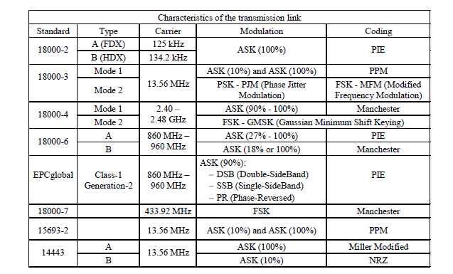
Transmission Characteristics: Reader to Tag

Slide 39
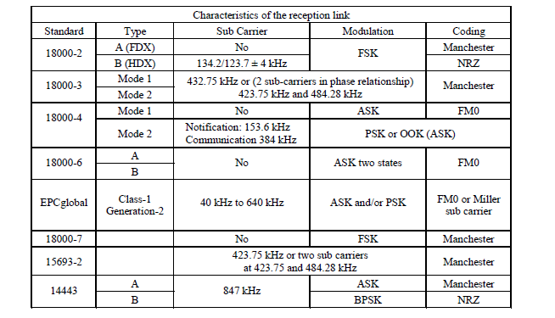
Transmission Characteristics: Tag to REader

Slide 40
Channel Coding
During transmissions of energy and data in the radio channel, various electromagnetic sources can cause transmission errors. In order to ensure the integrity of transmissions, it is necessary to detect the presence of errors in the received message. If this happens, the protocol should be able to transmit the message again unless the receiver can correct the message itself.
There are essentially three types of error detection modes:
Vertical Redundancy Check (VRC) that is also called the parity check;
Longitudinal Redundancy Check (LRC);
Cyclic Redundancy Check (CRC).

